Slide 1

Verot: India’s First Tilt-Rotor VTOL Drone Revolution
Unveiling a new era in Indian aerial technology, Verot is set to redefine versatility and efficiency in drone operations.
InnovAct 2025 — Robotics and DronesAmlan Jyoti (25BEE0085)Bhavesh (25BEE0079)Devang Tulsyan (25BEE0072)Aratrika Chakravarty (25BEE0083)
Yukti ID – IR2025-995960

Slide 2
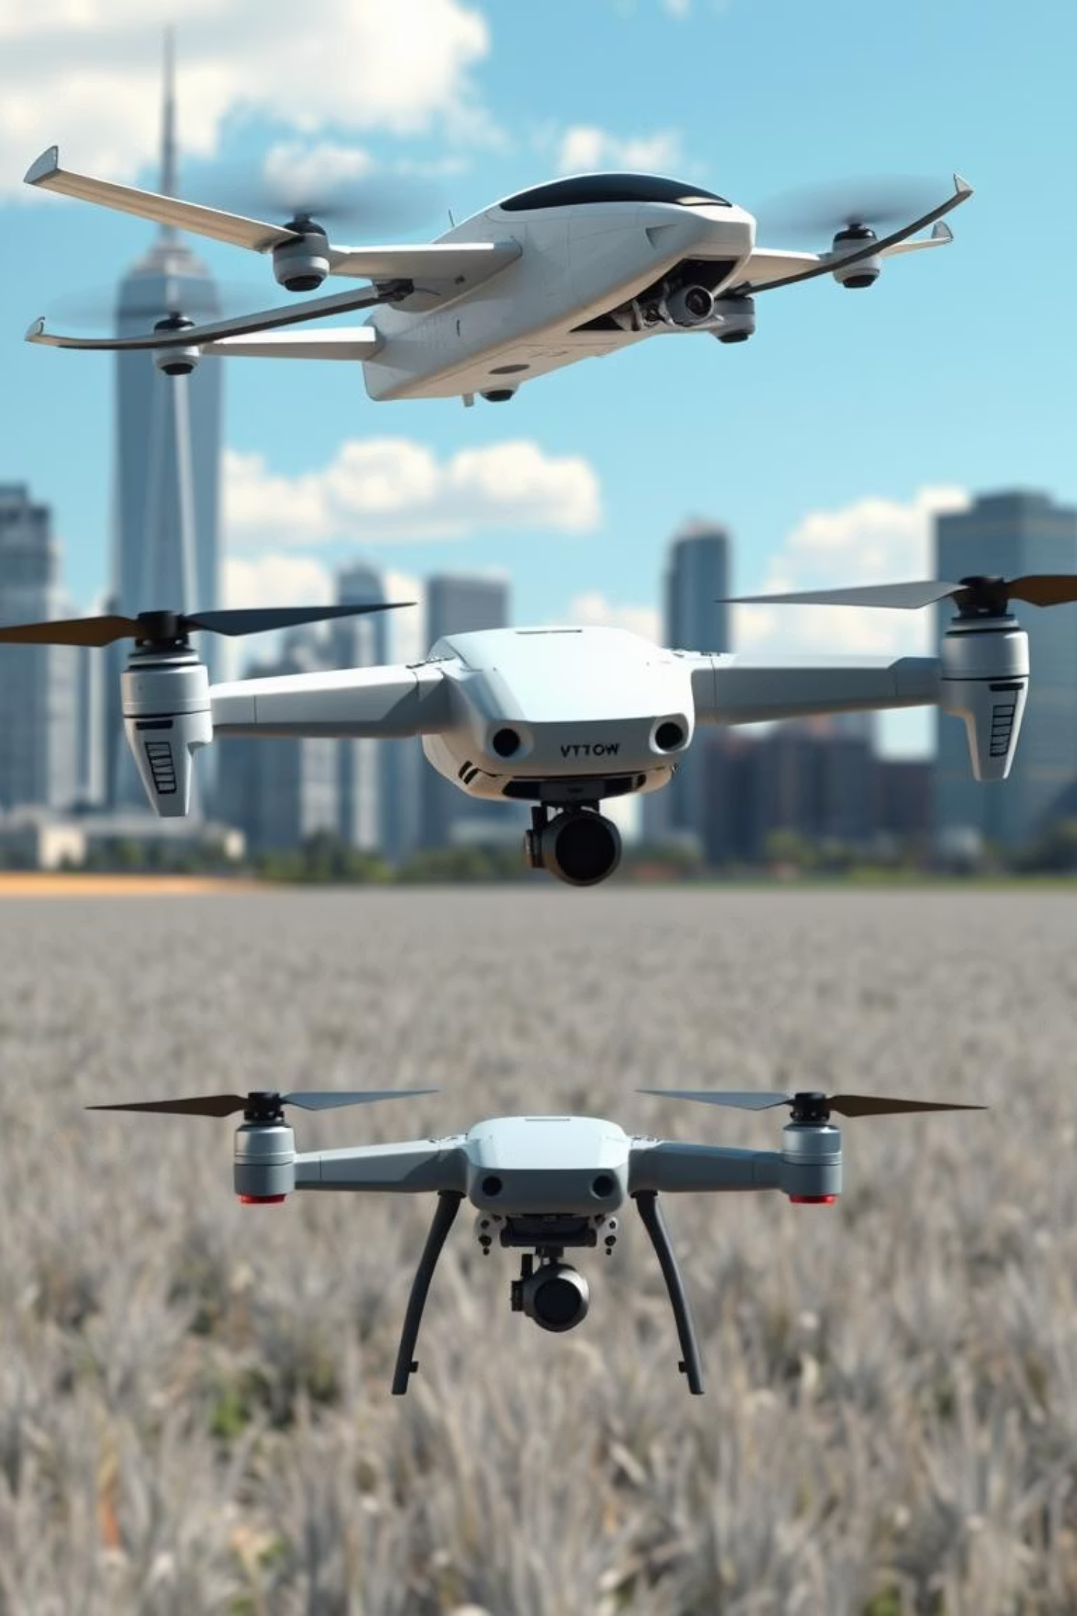
The Challenge: Current Drone Limitations
Conventional drones present a dilemma: fixed-wing models require open spaces for takeoff, while multirotors offer VTOL but are limited in range and endurance. Existing solutions that combine these capabilities are often prohibitively expensive and complex.
Cost & Complexity
Accessibility
High barriers to entry for innovators and organisations with limited resources.
Lack of affordable, modular VTOL solutions hinders widespread adoption and grassroots innovation.
Versatility Gap
A need for a single drone capable of autonomous vertical takeoff, efficient forward flight, and payload delivery.

Slide 3
What Makes Verot Unique?
1
2
3
Hybrid VTOL Innovation
Seamless Agility & Endurance
Groundbreaking Indian Technology
Verot introduces a pioneering tilt-rotor mechanism, allowing its front two rotors to tilt for efficient plane-mode flight, while the rear rotor remains fixed vertically.
This design expertly merges the ease of vertical takeoff and landing (VTOL) with the high speed and extended range typically associated with fixed-wing aircraft.
Verot represents a never-before-seen technological advancement in India, bridging the gap between agile helicopter capabilities and the enduring performance of airplanes.

Slide 4
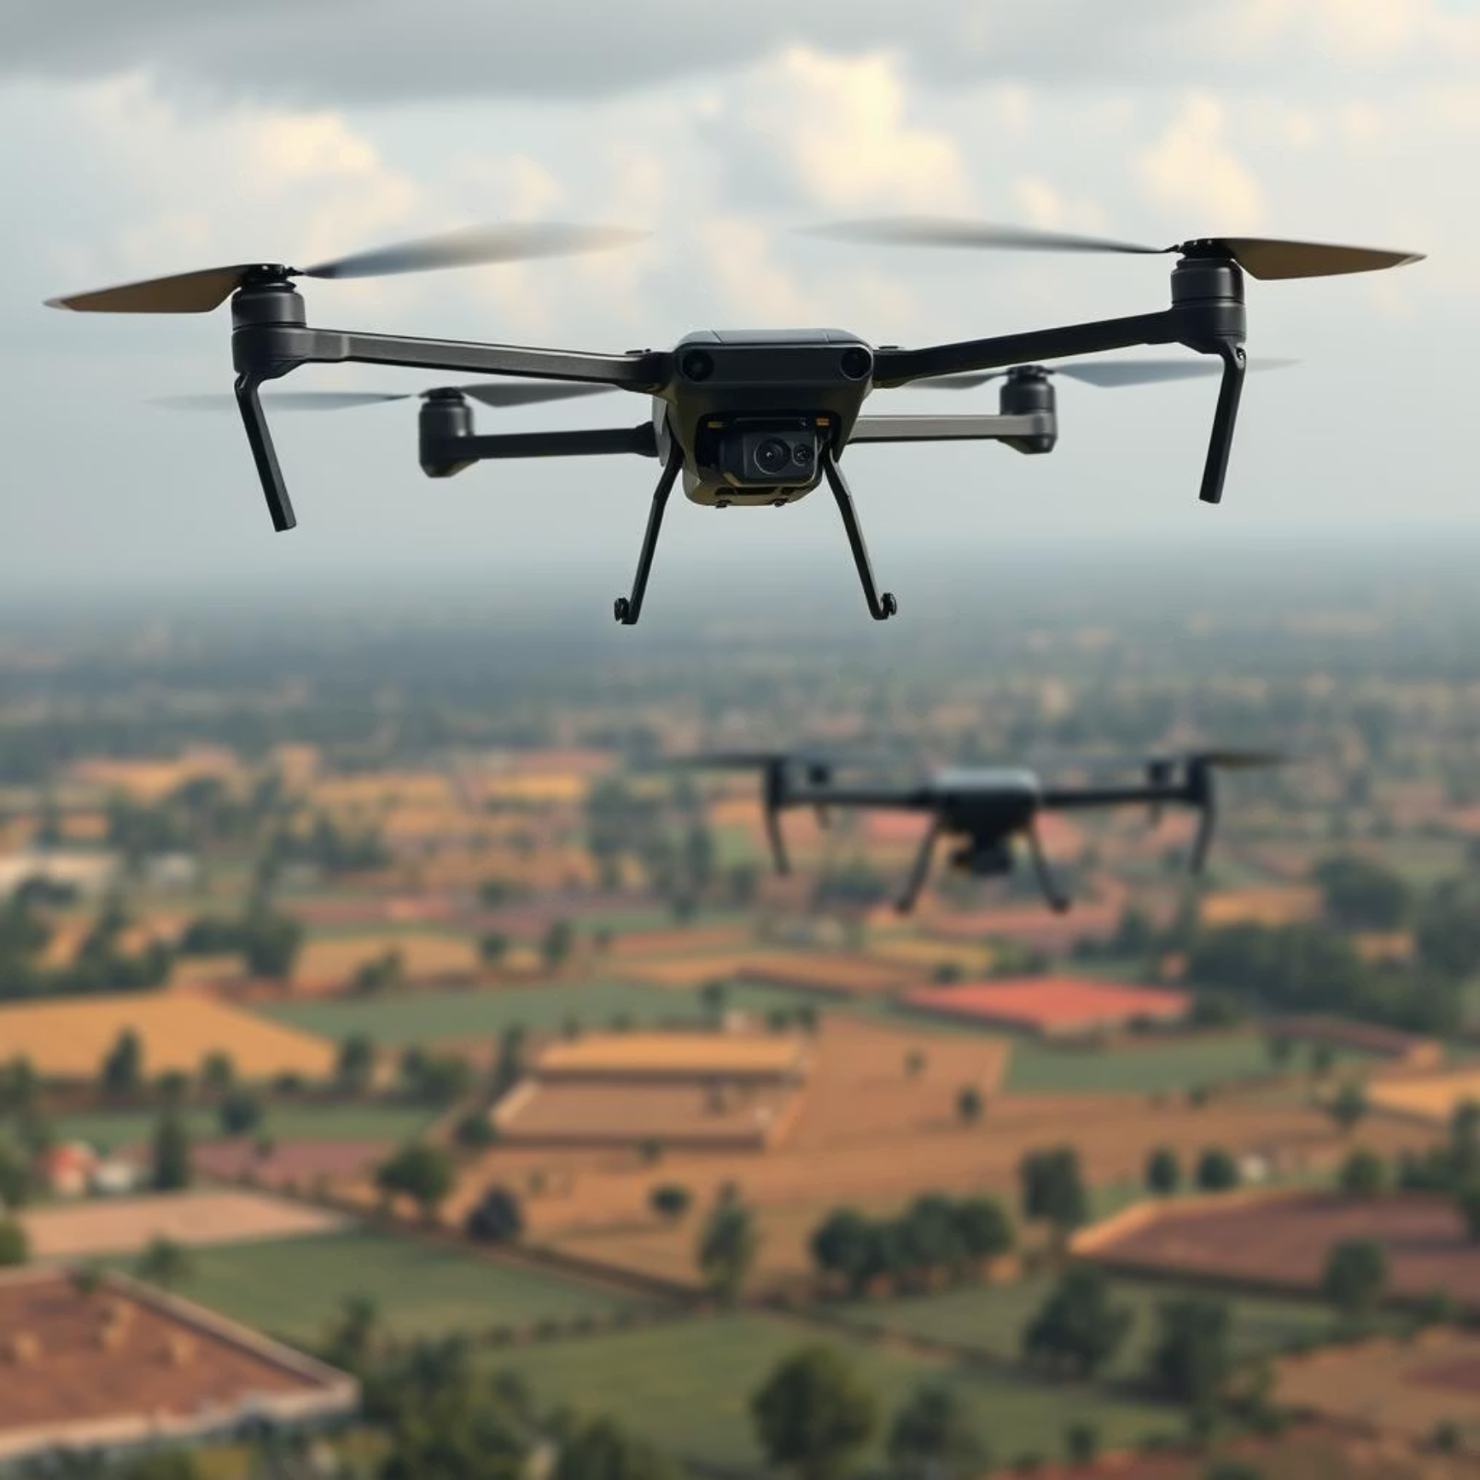
The VTOL Landscape in India: Where Verot Fits
Existing Indian VTOL drones, such as ideaForge’s Switch UAV and Solar Defence’s Rudrastra, primarily utilise fixed rotors or multiple lift rotors without tilt-rotor technology. These designs, while effective for specific tasks, often face inherent limitations in balancing sustained flight efficiency with the convenience of vertical takeoff and landing.
Verot’s innovative tilt-rotor design facilitates a much smoother transition between vertical lift and horizontal flight, achieving significantly higher flight efficiency compared to traditional multi-rotor VTOLs. This allows Verot to leverage the aerodynamic advantages of fixed-wing flight for extended periods, reducing energy consumption and enabling greater distances and longer operational times.
For instance, fixed-wing VTOLs generally require a transition period, and multi-rotor systems consume significant energy in forward flight due to constant powered lift, thereby limiting their operational range and endurance for longer missions. Their design necessitates compromises between speed, payload capacity, and flight duration, which can be critical in diverse Indian terrains and operational requirements.
Verot is strategically positioned to complement, and in many aspects surpass, the current indigenous drones in terms of endurance, payload flexibility, and overall mission versatility. Its capability to operate from confined spaces while delivering performance comparable to larger, more complex fixed-wing aircraft addresses a crucial gap in India's growing drone ecosystem, offering a superior solution for reconnaissance, logistics, and surveillance across varied environments.
This unique hybrid approach ensures that Verot can adapt to a wider array of applications, from critical defense operations to civilian infrastructure monitoring, without the typical trade-offs associated with conventional drone architectures. Verot not only fills a critical technological void but also aligns perfectly with India's "Atmanirbhar Bharat" (Self-Reliant India) initiative by fostering indigenous innovation in advanced aerospace technology. Its introduction marks a significant leap forward in making sophisticated VTOL capabilities more accessible and efficient for both strategic and commercial applications within the country.

Slide 5




How Verot Works: The Tilt-Rotor Advantage
Vertical Takeoff
Transition Phase
At takeoff, Verot functions like a standard quadcopter, using all rotors for vertical lift.
During transition, the front two rotors tilt forward, transferring lift to the wings for plane-mode cruise.
Stabilised Flight
Optimised Performance
The rear rotor remains vertical throughout, ensuring crucial stability and control during advanced manoeuvres.
This unique configuration results in considerably longer flight times, enhanced speeds, and highly energy-efficient missions.

Slide 6




Defence & Warfare Applications
Surveillance & Reconnaissance
Precision Payload Delivery
Extended range and endurance for critical intelligence gathering over vast areas.
Efficient delivery of lightweight munitions or essential supplies via a secure cargo bay.
Rapid Deployment
Strategic Autonomy
Vertical takeoff from constrained spaces enables quick response in conflict or disaster zones.
Enhances India’s defence capabilities with cutting-edge indigenous drone technology.

Slide 7




Industrial & Civilian Use Cases
Aerial Mapping & GIS
Weather & Environment
High-precision surveys over extensive areas, facilitated by efficient flight.
Vital data collection in remote or disaster-affected regions, supporting crucial analysis.
Cargo Transport
Infrastructure Inspection
Flexible payload bay for urgent medical supplies or critical relief materials in inaccessible areas.
Stable hover and long flight times ideal for inspecting bridges, power lines, and pipelines.

Slide 8
Verot vs. Competitors: Key Performance Highlights
Flight Endurance
2+ hours
~2 hours
~1.5 hours
Payload Versatility
Modular cargo bay for defence or commercial use
Limited customisation
Specific mission payloads
Operational Flexibility
No runway needed; deployable in urban, forest, flood zones
Requires clear launch/landing zones
Requires clear launch/landing zones
Advanced Control
Seamless tilt-rotor transition for reliability
Fixed-rotor control
Fixed-rotor control

Slide 9
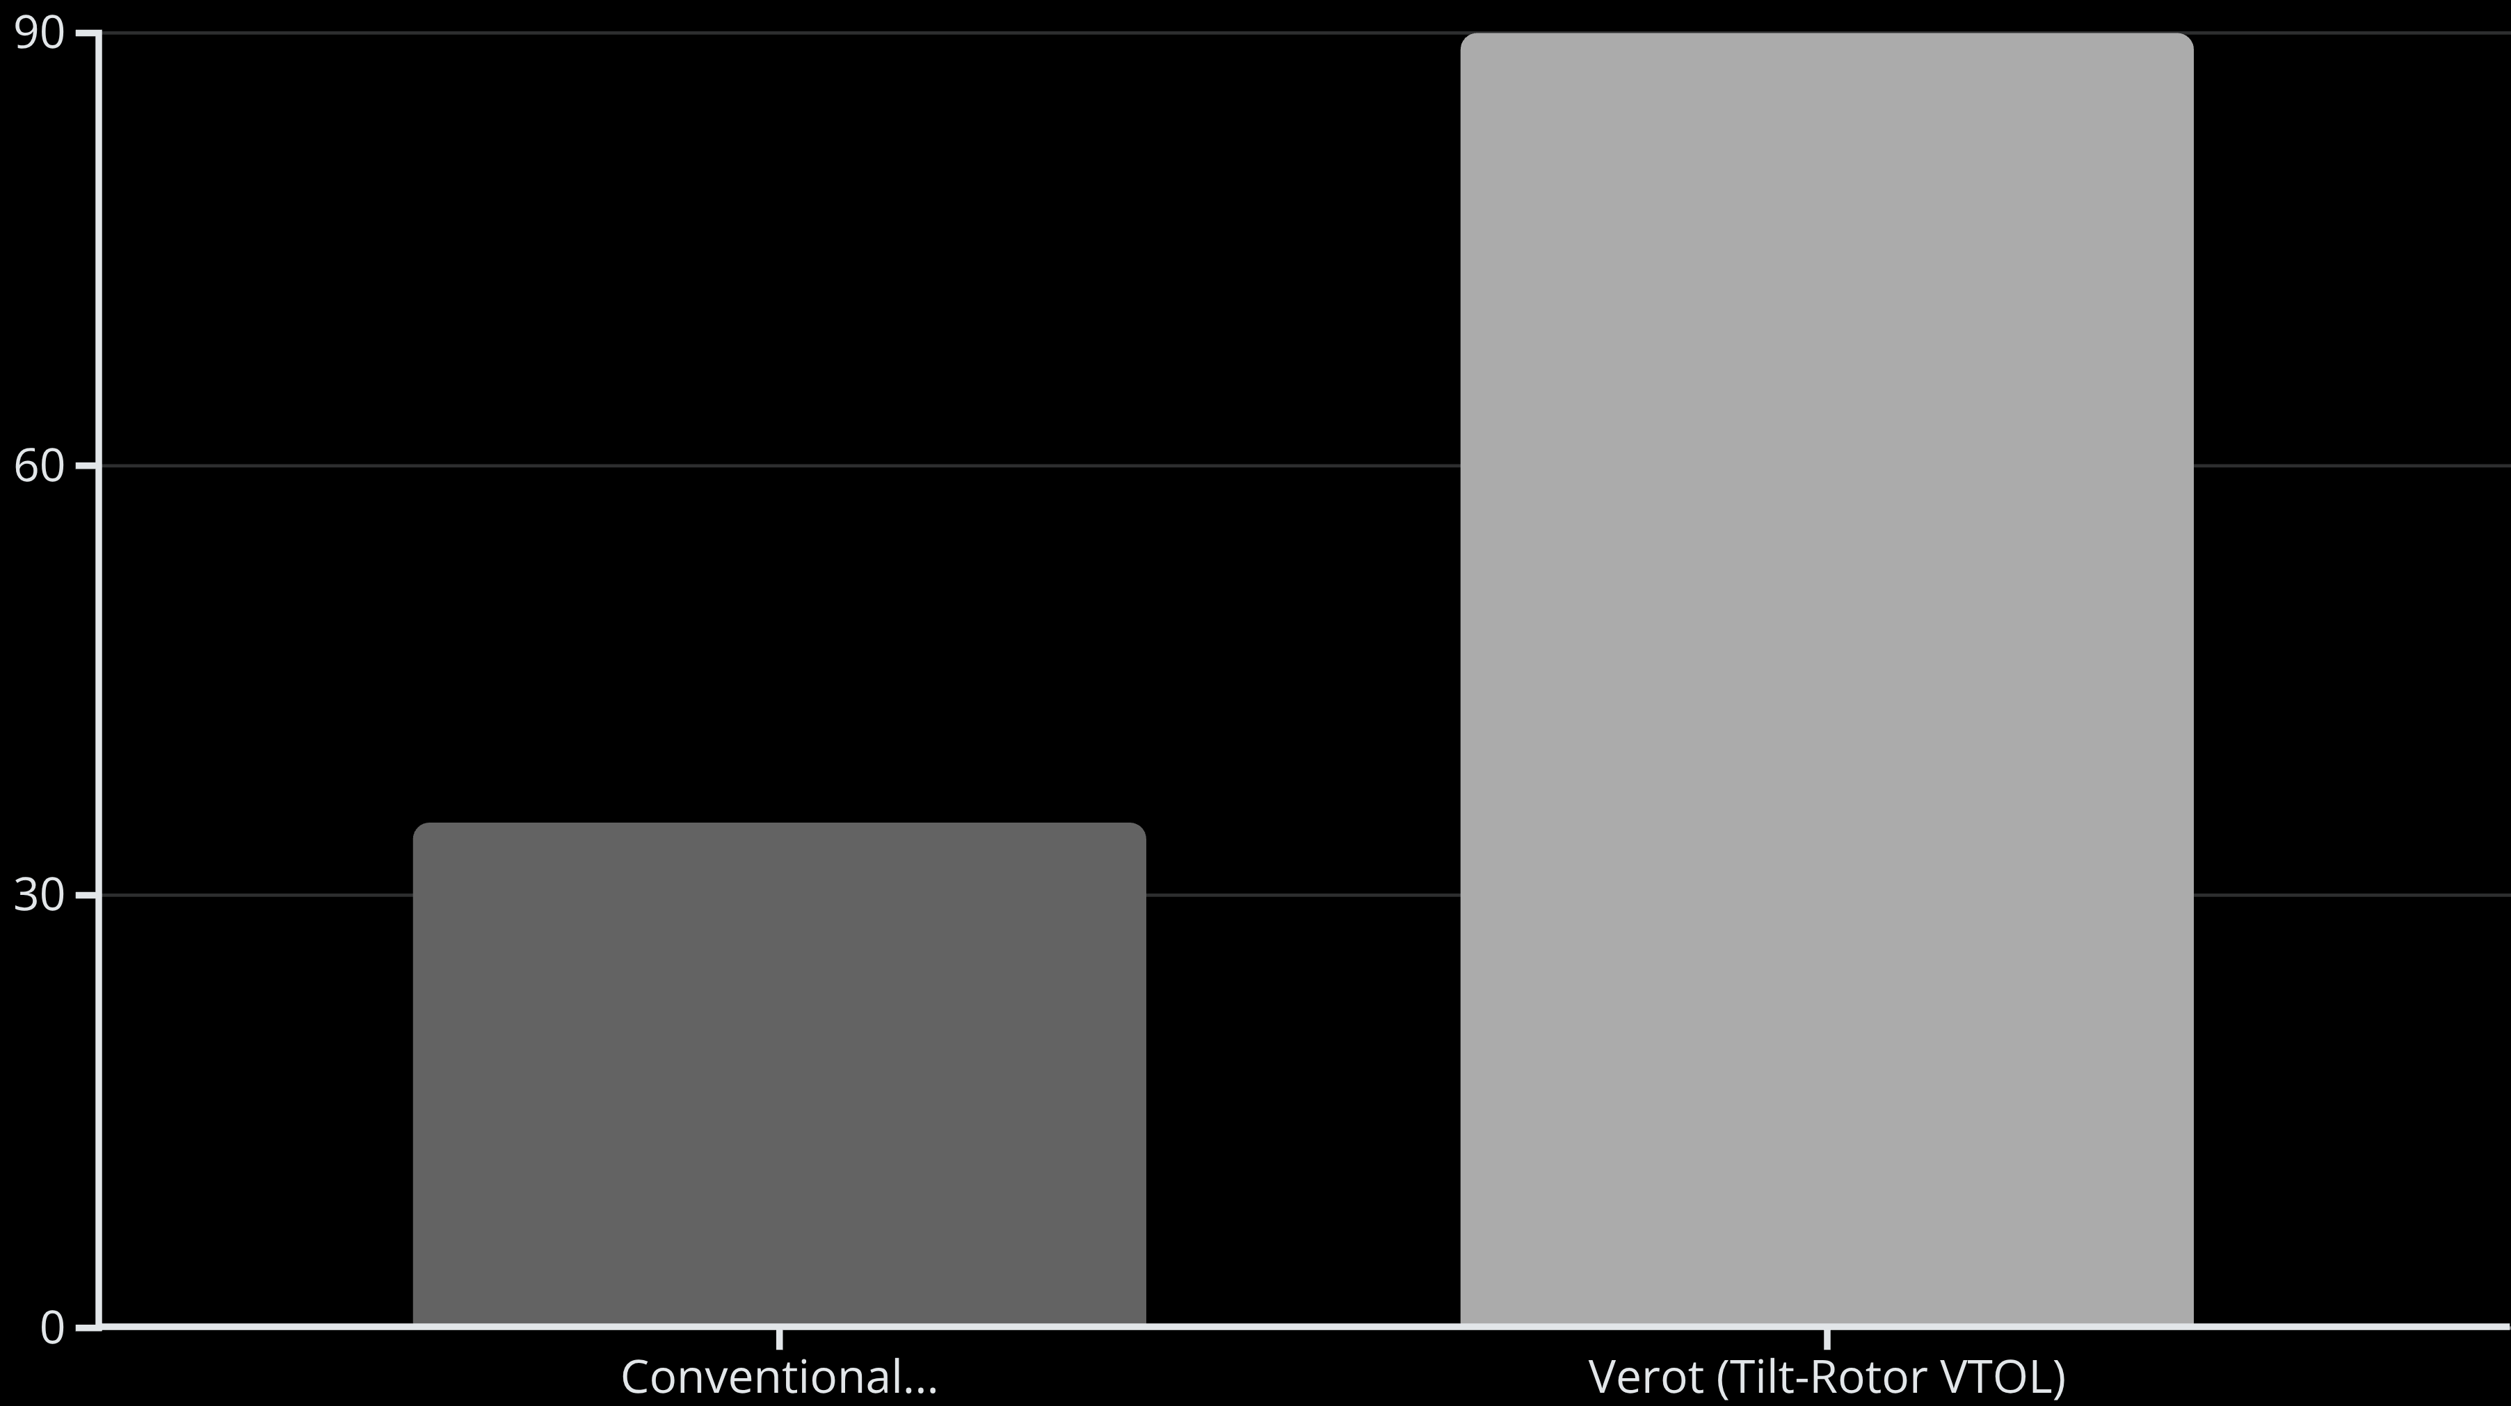
Verot's Propulsive Advantage: Quantifying the Difference
While traditional multi-rotor drones rely solely on propeller thrust for both lift and forward motion, often battling drag inefficiently in cruise flight, Verot's innovative tilt-rotor system drastically redefines propulsive efficiency.
By transitioning from vertical lift to fixed-wing flight, Verot leverages aerodynamic lift from its wings, allowing its propellers to focus almost entirely on generating forward thrust. This fundamental shift reduces the energy required to sustain flight, leading to a significantly higher effective propulsive force for a given power output compared to conventional drones.
This efficiency translates directly into extended range, higher speeds, and greater payload capacity without increasing power consumption, making Verot a game-changer in VTOL drone technology.

Slide 10
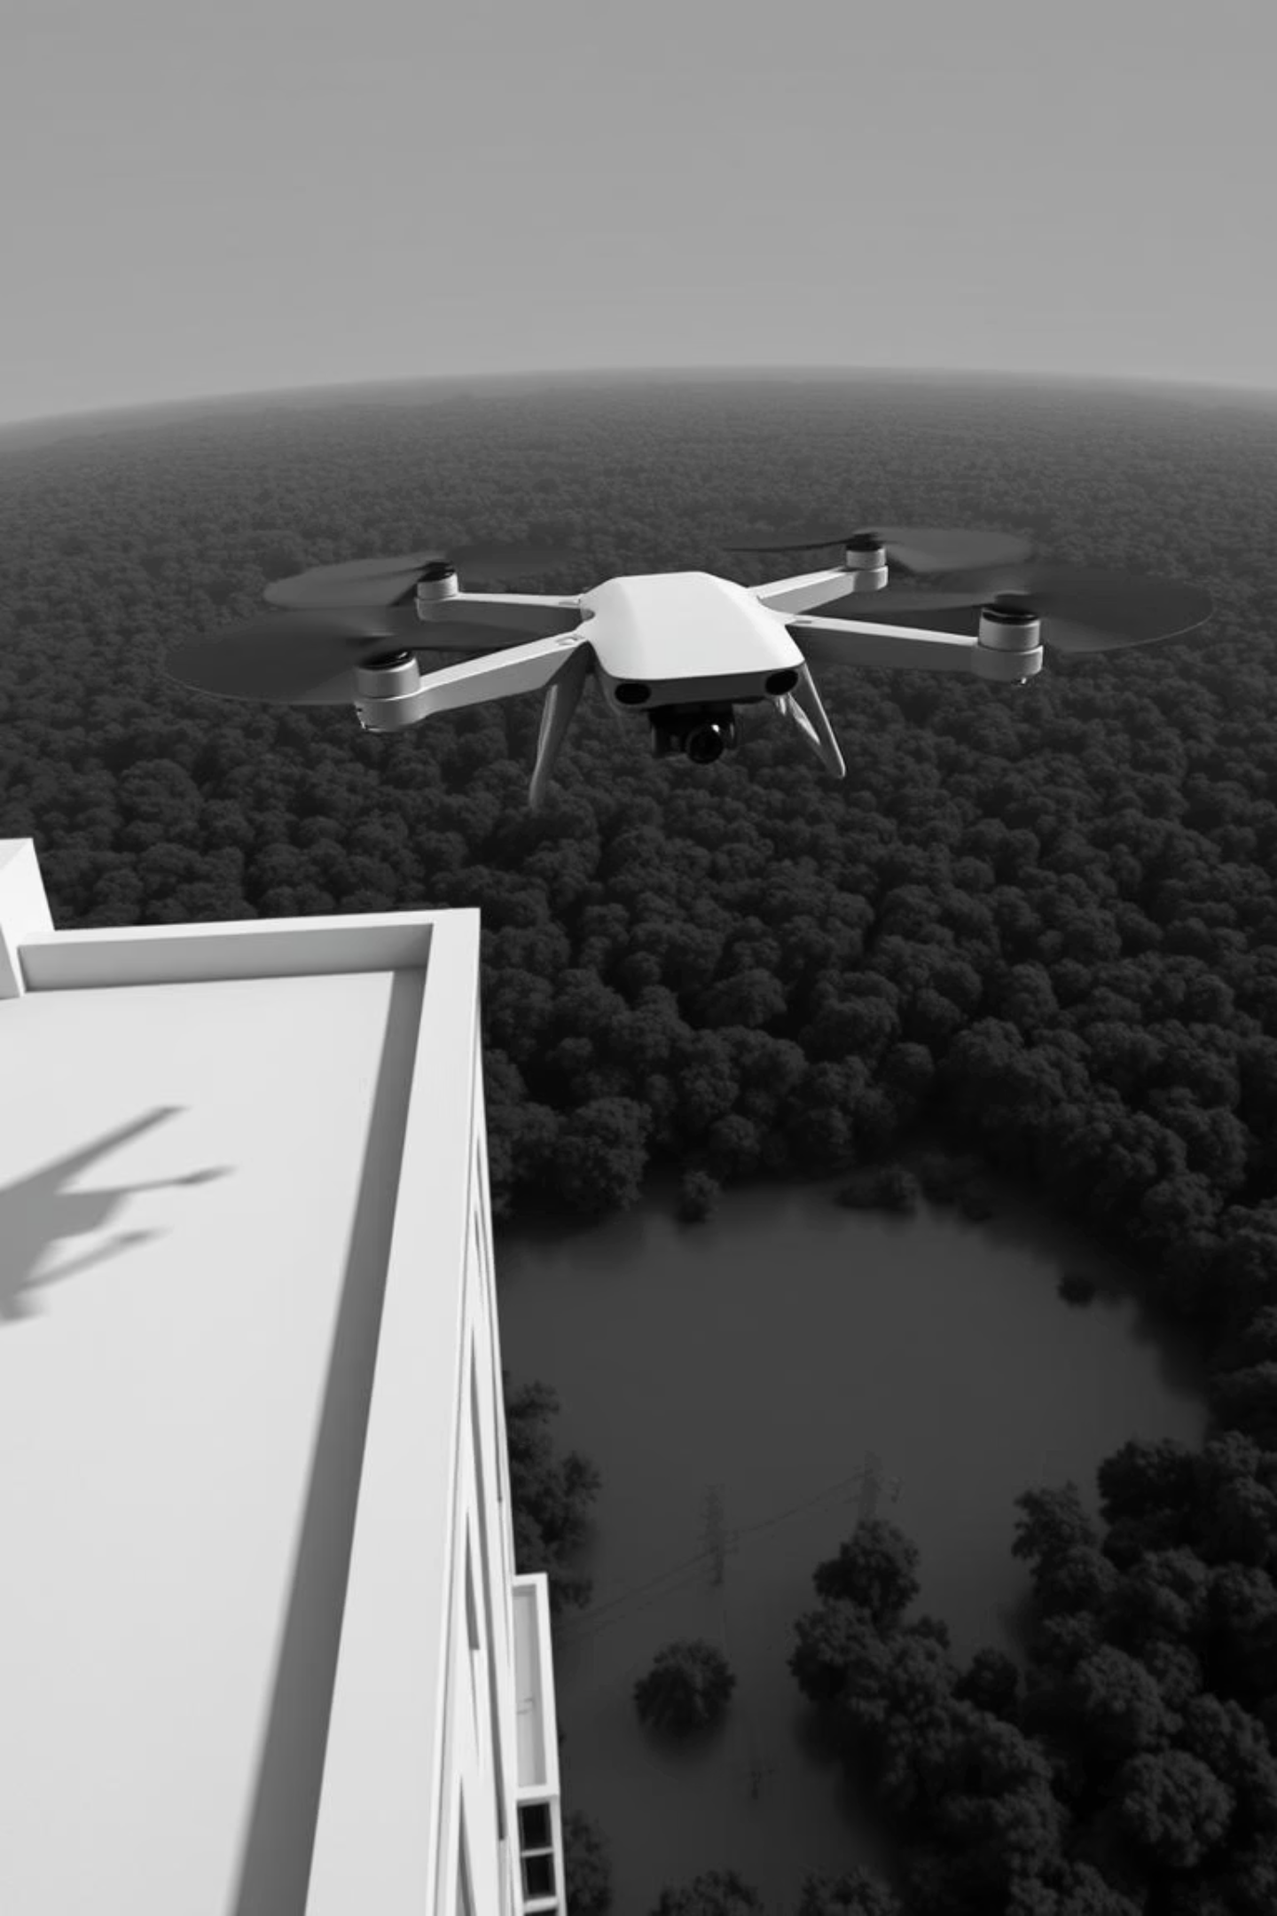
From Hover to Cruise: The Future of Indian VTOL Flight

Slide 11
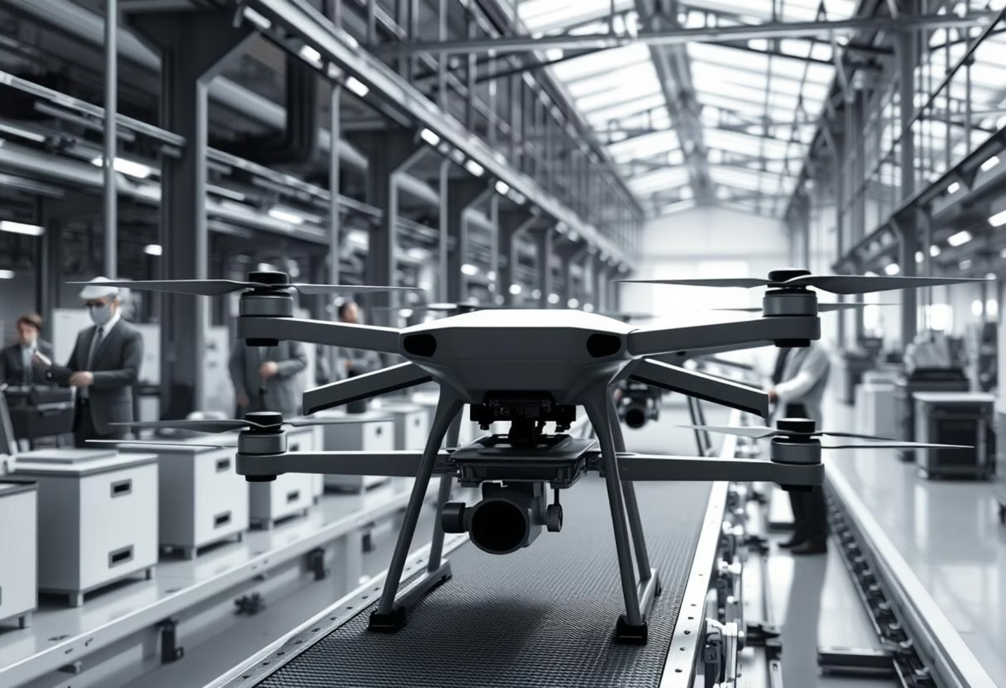
Our Journey: Overcoming Challenges, Charting the Future
Engineering the Impossible
Developing the precise tilt-rotor mechanism and integrating complex flight control algorithms for seamless VTOL and horizontal flight demanded rigorous R&D and countless iterations. We conquered this through dedicated expertise and advanced simulation.
Localising Production
Establishing an entirely indigenous supply chain for specialised components and scaling manufacturing within India presented significant logistical and quality control challenges. Strategic partnerships and continuous process refinement were key to overcoming this.
Navigating Certification
Achieving the necessary regulatory approvals and airworthiness certifications for a groundbreaking VTOL drone in India was an exhaustive process. Close collaboration with authorities and meticulous documentation ensured compliance.
Scaling for Mass Adoption
Our current focus is on rapidly scaling production to meet anticipated demand while maintaining stringent quality standards. This involves further optimising manufacturing processes and expanding our skilled workforce.
Integrating Advanced AI
The next frontier involves embedding more sophisticated AI for autonomous decision-making, predictive maintenance, and enhanced payload intelligence, pushing the boundaries of what Verot can achieve.

Slide 12
The Road Ahead: Scaling Verot’s Impact
01
02
Development & Trials
Strategic Collaborations
Prototype development and rigorous field trials are slated for late 2025, ensuring robust performance.
Exploring key collaboration opportunities with both defence agencies and industrial partners to maximise reach and application.
03
04
Ecosystem Catalysation
Vision for Autonomy
Potential to significantly accelerate India’s drone ecosystem through homegrown tilt-rotor innovation, fostering local talent and industry.
Our long-term vision positions Verot as a multi-mission platform, integral to powering India’s aerial autonomy and enhancing disaster resilience across the nation.

Slide 13
Verot: Elevating India’s Skies with Innovation and Purpose
Pioneering tilt-rotor VTOL technology for unmatched efficiency and versatility in drone operations.
Empowering defence, industry, and humanitarian missions with a single, highly adaptable platform.
Join us in shaping the future of Indian drone technology—where every flight is a monumental leap forward.

